Slide 1
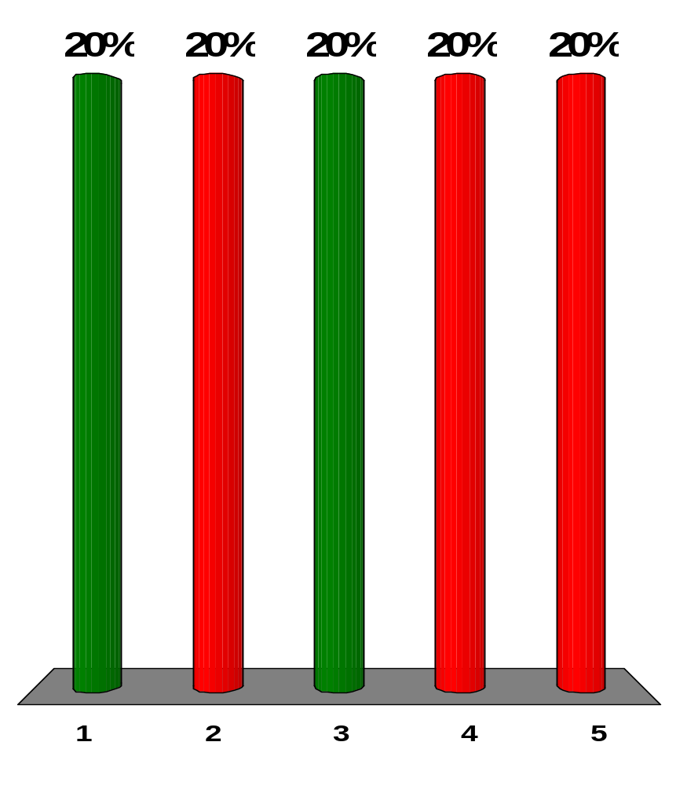
When an image of an object is formed by a plane mirror, which of the following statements is always true?
The image is virtual.
The image is real.
The image is upright.
The image is inverted.
None of those statements is always true.
Notes:
Remarks for instructors: Answers (1) and (3). The image of a real object formed by a plane mirror is always an upright and virtual image, which is the same size as the object and located as far behind the mirror as the object is in front of the mirror.

Slide 2
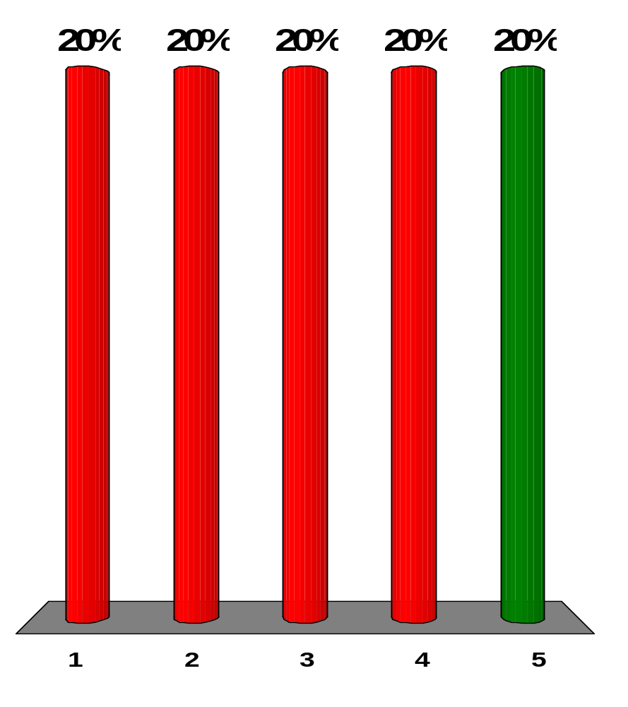
When the image of an object is formed by a concave mirror, which of the following statements are always true?
The image is virtual.
The image is real.
The image is upright.
The image is inverted.
None of those statements is always true.
Notes:
Remarks for instructors: Answer (5). A concave (converging) mirror forms real, inverted images of real objects located outside the focal point (p>f), and virtual, upright images of real objects located inside the focal point (p<f) of the mirror.

Slide 3
When the image of an object is formed by a convex mirror, which of the following statements are always true?
The image is virtual.
The image is real.
The image is upright.
The image is inverted.
None of those statements is always true.
Notes:
Remarks for instructors: Answers (1) and (3). With a real object in front of a convex (diverging) mirror, the image is always virtual, upright, and diminished in size, and located between the mirror and the focal point.

Slide 4
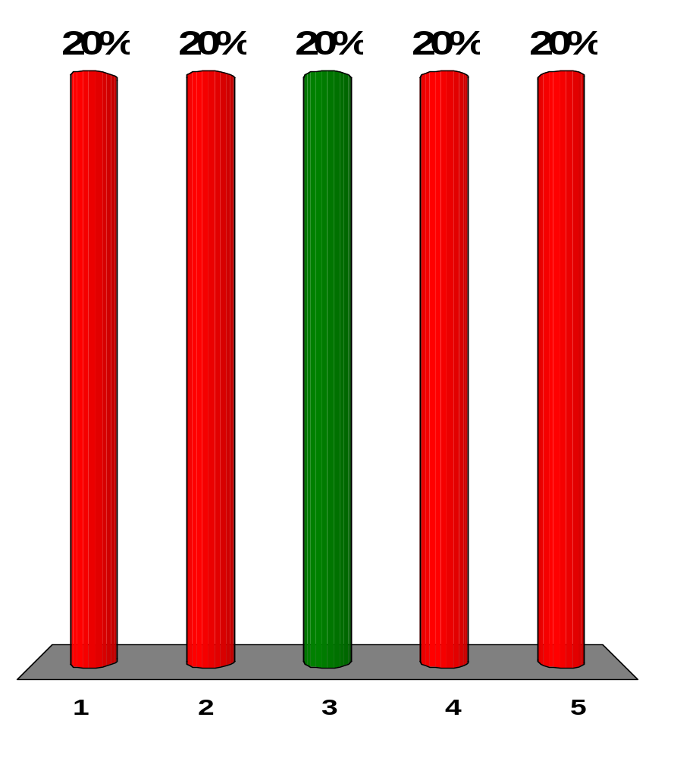
If you increase the aperture diameter of a camera by a factor of 3, how is the intensity of the light striking the film affected?
It increases by factor of 3.
It decreases by a factor of 3.
It increases by a factor of 9.
It decreases by a factor of 9.
Increasing the aperture size doesn’t affect the intensity.
Notes:
Remarks for instructors: Answer (3). The amount of light focused on the film by a camera is proportional to the area of the aperture through which the light enters the camera. Since the area of a circular opening varies as the square of the diameter of the opening, the light reaching the film is proportional to the square of the diameter of the aperture. Thus, increasing this diameter by a factor of 3 increases the amount of light by a factor of 9.

Slide 5

An object is located 50.0 cm from a converging lens having a focal length of 15.0 cm. Which of the following statements is true regarding the image formed by the lens?
It is virtual, upright, and larger than the object.
It is real, inverted, and smaller than the object.
It is virtual, inverted, and smaller than the object.
It is real, inverted, and larger than the object.
It is real, upright, and larger than the object.
Notes:
Remarks for instructors: Answer (2). A converging lens forms real, inverted images of real objects located outside the focal point.
1/p + 1/q = 1/f: 1/50.0 cm + 1/q = 1/15.0 cm → q = 21.4 cm
M = -q/p = -21.4 cm/50.0 cm = -0.429
The positive image distance confirms that the image is real, and the negative magnification confirms that the image is inverted. Also, M = -0.429 tells us the image is smaller than the object.

Slide 6
When an image of an object is formed by a converging lens, which of the following statements is always true? More than one statement may be correct.
The image is virtual.
The image is real.
The image is upright.
The image is inverted.
None of those statements is always true.
Notes:
Remarks for instructors: Answer (5). A converging lens forms real, inverted images of real objects located farther than the focal length (p>f), and virtual, upright images of real objects located closer than the focal length (p<f).

Slide 7
When the image of an object is formed by a diverging lens, which of the statements is always true? More than one statement may be correct.
The image is virtual.
The image is real.
The image is upright.
The image is inverted.
None of those statements is always true.
Notes:
Remarks for instructors: Answers (1) and (3). A diverging lens forms a virtual, upright, and diminished image of any real object located any distance from the lens.

Slide 8
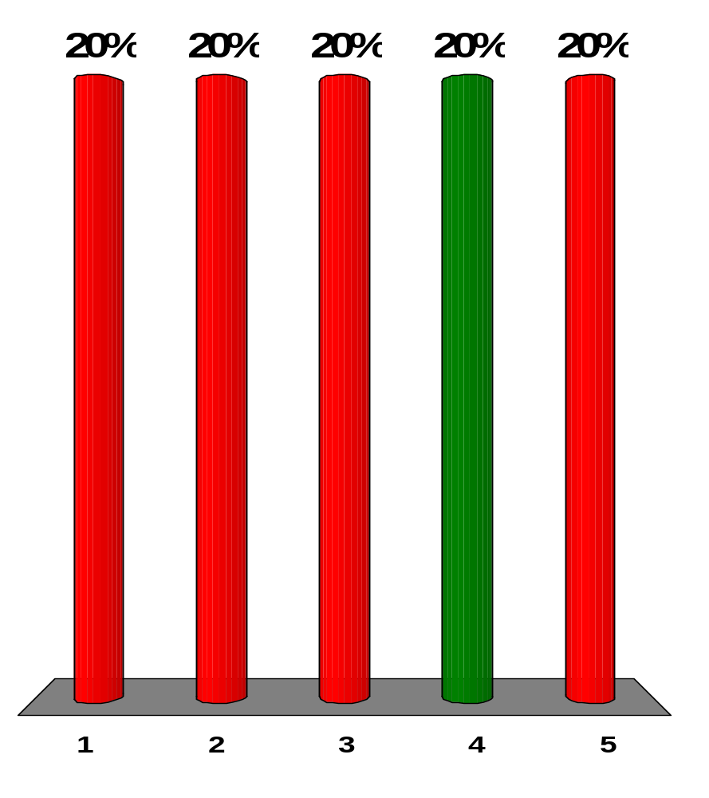
A converging lens made of crown glass has a focal length of 15.0 cm when used in air. If the lens is immersed in water, what is its focal length?
negative
less than 15.0 cm
equal to 15.0 cm
greater than 15.0 cm
none of those answers
Notes:
Remarks for instructors: Answer (4). We can answer this question conceptually by noting that if the lens were surrounded by water, parallel light rays passing into and out of the lens would experience smaller changes in the index of refraction, so they would bend less, and so would focus farther from the lens.
We can answer this question quantitatively if we consider the derivation of the lens makers’ equation in section 36.4 for the general case of the lens being surrounded by a medium of index n₀ =1. We would conclude that Equation 36.15 takes the general form
1/f = (n/n₀ - 1)(1/R₁ – 1/R₂)
So, for a lens of crown glass (n=1.52, from Table 35.1) surrounded by air, n₀ = 1, we have
1/f = (1.52 - 1)(1/R₁ – 1/R₂) = 1/15.0 cm
But for a lens surrounded by water, n₀ = 1.33, and we have
1/f = (1.52/1.33 - 1)(1/R₁ – 1/R₂)
= [(1.52/1.33 - 1)/(1.52-1)][(1.52-1)(1/R₁ – 1/R₂)]
= [(1.52/1.33 - 1)/(1.52-1)][(1.52-1)(1/15.0 cm)]

Slide 9
If Josh’s face is 30.0 cm in front of a concave shaving mirror creating an upright image 1.50 times as large as the object, what is the mirror’s focal length?
12.0 cm
20.0 cm
70.0 cm
90.0 cm
none of those answers
Notes:
Remarks for instructors: Answer (d). The image is upright, so the magnification is positive:
M = -q/p: +1.50 = -1/30.0 cm → q = -45.0 cm
1/p + 1/q = 1/f: 1/30.0 cm + 1/(-45.0 cm) = 1/f → f = 90.0

Slide 10
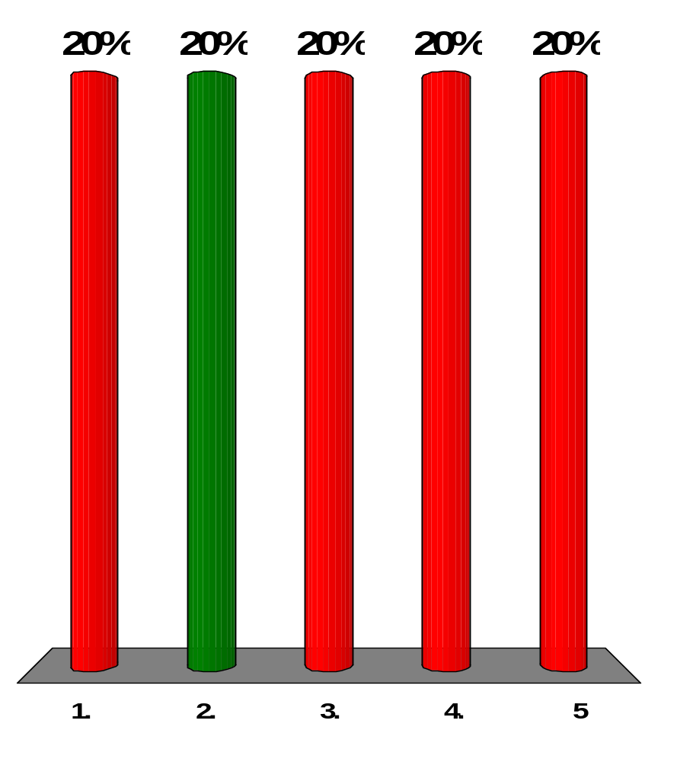
Two thin lenses of focal lengths f₁ = 15.0 and f₂ = 10.0 cm, respectively, are separated by 35.0 cm along a common axis. The f₁ lens is located to the left of the f₂ lens. An object is now placed 50.0 cm to the left of the f₁ lens, and a final image due to light passing though both lenses forms. By what factor is the final image different in size from the object?
0.600
1.20
2.40
3.60
none of those answers
Notes:
Remarks for instructors: Answer (2). For lens 1, the object distance p₁ = 500. cm:
1/p₁ + 1/q₁ = 1/f₁: 1/50.0 cm + 1/q₁ = 1/15.0 cm → q₁ = 21.4 cm
The image distance is positive, so the image is real and forms 21.4 cm to the right of lens 1.
The image of lens 1 is the object of lens 2. For lens 2, the object distance
p₂ = 35.0 cm − 21.4 cm =13.6 cm:
1/p₂ + 1/q₂ = 1/f₂: 1/50.0 cm + 1/q₂ = 1/10.0 cm → q₂ = 38.0 cm
The image distance is positive, so the image is real and forms 38.0 cm to the right of lens 2.
From M = M₁M₂, the overall magnification is
M = M₁M₂ =(-q₁/p₁)(-q₂/p₂) = 1.20

Slide 11
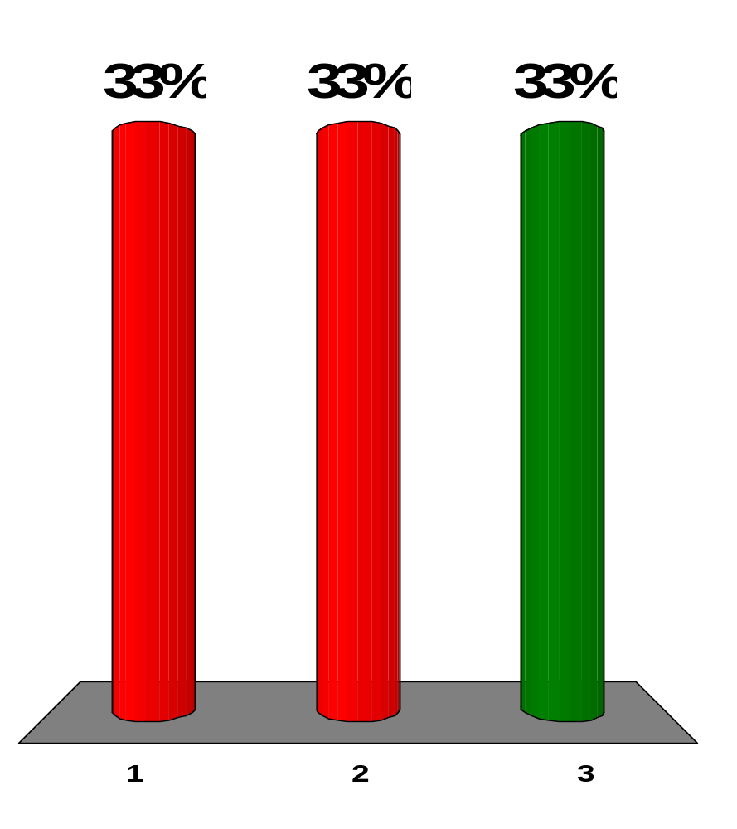
Lulu looks at her image in a makeup mirror. It is enlarged when she is close to the mirror. As she backs away, the image becomes larger, then impossible to identify when she is 30.0 cm from the mirror, then upside down when she is beyond 30.0 cm, and finally small, clear, and upside down when she is much farther from the mirror. The mirror is:
convex.
plane.
concave.
Notes:
Remarks for instructors: Answer (3). When the object is at the focal point the image can be thought of as a right side up image behind the mirror at infinity, or as an inverted image in front of the mirror.

Slide 12
Lulu looks at her image in a makeup mirror. It is enlarged when she is close to the mirror. As she backs away, the image becomes larger, then impossible to identify when she is 30.0 cm from the mirror, then upside down when she is beyond 30.0 cm, and finally small, clear, and upside down when she is much farther from the mirror. What is the magnitude of its focal length?
0
15 cm
30 cm
60 cm
∞
Notes:
Remarks for instructors: Answer (3). When the object is at the focal point the image can be thought of as a right side up image behind the mirror at infinity, or as an inverted image in front of the mirror.

Slide 13
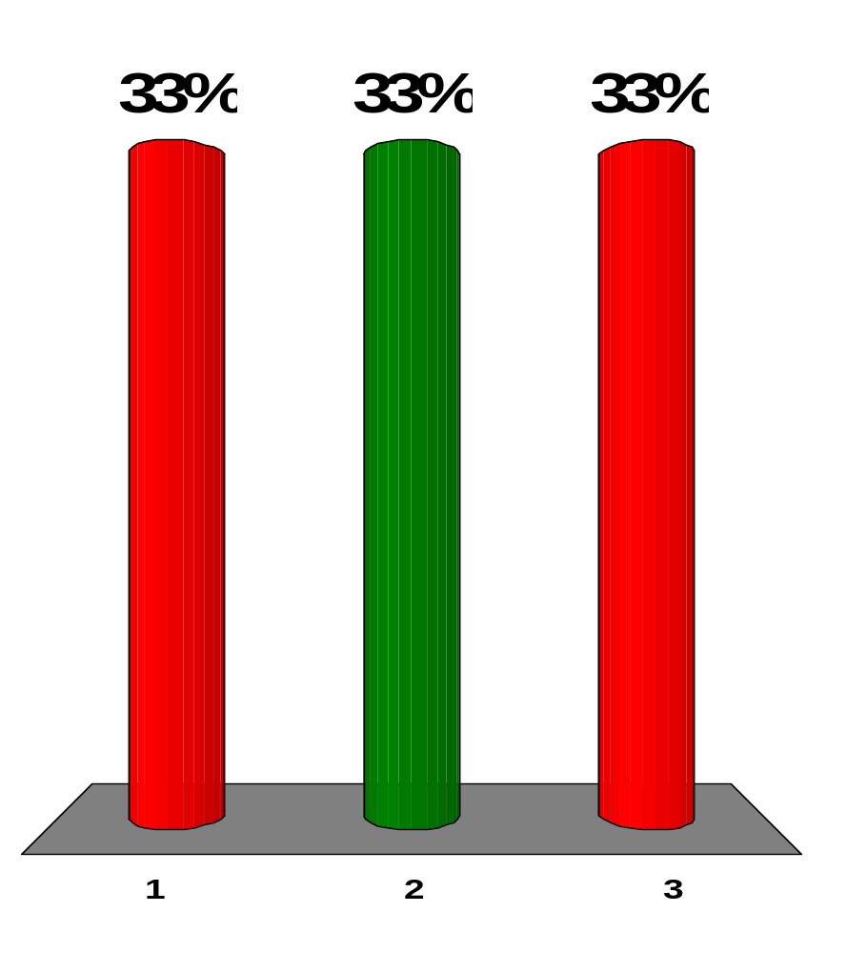
A person spearfishing from a boat sees a stationary fish a few meters away in a direction about 30° below the horizontal. To spear the fish, and assuming the spear does not change direction when it enters the water, the person should:
aim above where he sees the fish.
aim below the fish.
aim precisely at the fish.
Notes:
Remarks for instructors: Answer (3). The angle of refraction for the light coming from fish to person is 60°. The angle of incidence is smaller, so the fish is deeper than it appears.

Slide 14
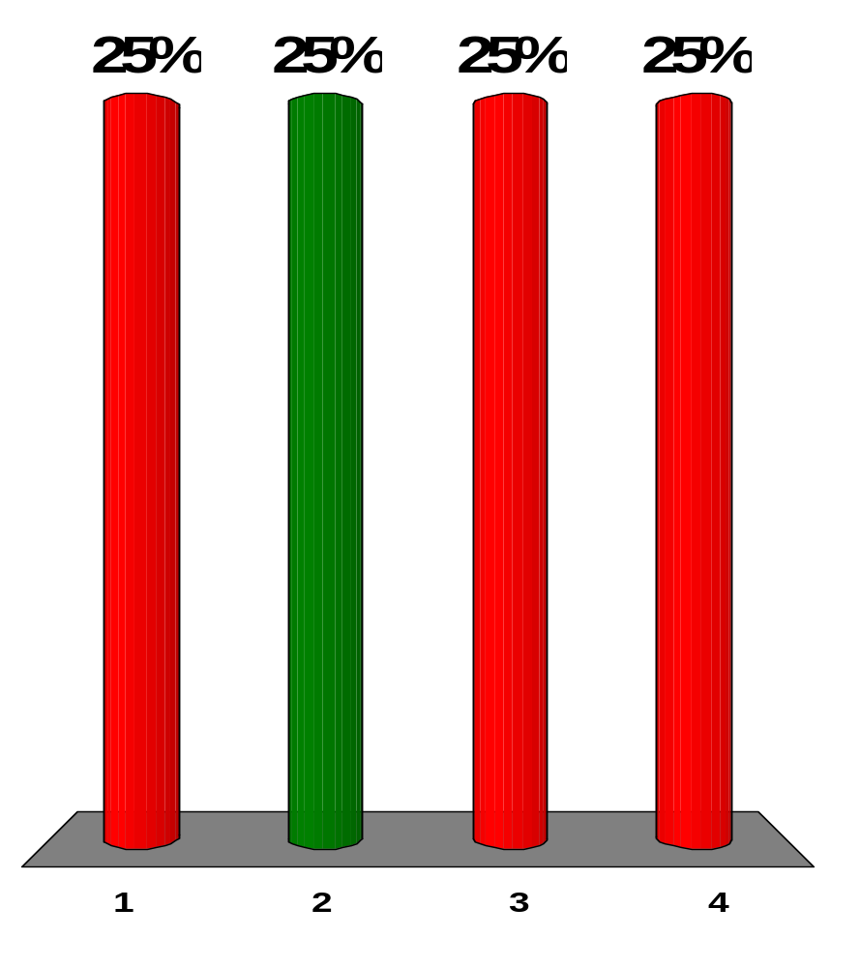
Model each of the following devices in use as consisting of a single converging lens. Rank the cases according to the ratio of the distance from the object to the lens to the focal length of the lens, from the largest ratio to the smallest.
(a) a film-based movie projector showing a movie
(b) a magnifying glass being used to examine a postage stamp
(c) an astronomical refracting telescope being used to make a sharp image of stars on an electronic detector
(d) a searchlight being used to produce a beam of parallel rays from a point source
(e) a camera lens being used to photograph a soccer game
b > a > e > c > d
c > e > a > d > b
e > d > c > b > a
a > b > e > d > c
Notes:
Remarks for instructors: Answer (2). In case (c), the object distance is effectively infinite. In (e) the object distance is very large compared to the focal length, but not infinite. In (a), the object distance is a little larger than the focal length. In (d) the object distance is equal to the focal length. In (b) the object distance is less than the focal length.

Slide 15
A converging lens in a vertical plane receives light from an object and forms an inverted image on a screen. An opaque card is then placed next to the lens, covering only the upper half of the lens. What happens to the image on the screen?
The upper half of the image disappears.
The lower half of the image disappears.
The entire image disappears.
The entire image is still visible, but is dimmer.
No change in the image occurs.
Notes:
Remarks for instructors: Answer (4). The entire image is visible, but only at half the intensity. Each point on the object is a source of rays that travel in all directions. Thus, light from all parts of the object goes through all unblocked parts of the lens and forms an image. If you block part of the lens, you are blocking some of the rays, but the remaining ones still come from all parts of the object.

Slide 16
A converging lens of focal length 8 cm forms a sharp image of an object on a screen. What is the smallest possible distance between the object and the screen?
0
4 cm
8 cm
16 cm
32 cm
Notes:
Remarks for instructors: Answer (5). At the smallest distance the object and image distances are equal, p = q:
1/p + 1/q = 1/f: 1/p + 1/p = 1/f → 2/p = 1/f → p = 2f = q

Slide 17
The faceplate of a diving mask can be ground into a corrective lens for a diver who does not have perfect vision. The proper design allows the person to see clearly both under water and in the air. Normal eyeglasses have lenses with both the front and back surfaces curved. The lenses of a diving mask should be curved:
on the outer surface only.
on the inner surface only.
on both surfaces.
Notes:
Remarks for instructors: Answer (2). A change in the medium in contact with the outer surface will result in a change in refraction at the outer surface if the surface is curved. Refraction should be limited to the inner surface because the medium inside (air) does not change. The outer surface should be flat so that it will not produce a fuzzy or distorted image for the diver when the mask is used either in air or in water.

Slide 18
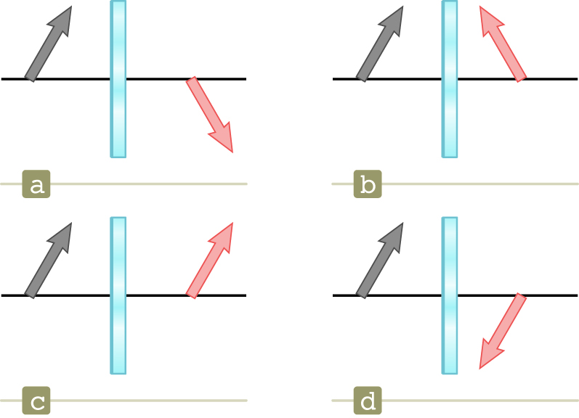
An object, represented by a gray arrow, is placed in front of a plane mirror. Which of the diagrams in Figure OQ36.14 correctly describes the image, represented by the pink arrow?
[Figure OQ36.14]
a
b
c
d
Notes:
Remarks for instructors: Answer (2). The image is upright, and corresponding parts of the object and image are the same distance from the mirror.

